Slide 1
Digital Portfolio
STUDENT NAME: HAMATHI THAZIN A
REGISTER NO AND NMID: astvu346m24321
DEPARTMENT: BCA
COLLEGE : MMES ARTS AND SCIENCE COLLEGE, MELVISHARAM

Slide 2
PROJECT TITLE
STUDENT DIGITAL PORTFOLIO

Slide 3


AGENDA
Problem Statement
Project Overview
End Users
Tools and Technologies
Portfolio design and Layout
Features and Functionality
Results and Screenshots
Conclusion
Github Link
3/21/2024 Annual Review

Slide 4

PROBLEM STATEMENT
In today's digital era, traditional resumes alone are not enough to showcase skills and projects effectively. Many students and professionals lack a structured online presence to highlight their work. A digital portfolio provides an interactive and accessible platform to present achievements, skills, and experiences.

Slide 5

PROJECT OVERVIEW
HTML (index.html) → Structure of the portfolio with sections:
•Header + Navigation
•About Me
•Skills
•Projects
•Contact (with your email: hamathithazin.718@gmail.com)
•Footer
CSS (style.css) → Styling and design:
•Gradient background color
•Sticky navigation bar
•Cad-style projects
•Hover & animation effects (fade, slide, scale)

Slide 6
JavaScript (script.js) → Interactivity:
•Smooth scrolling between sections
•Fade-in animation when sections come into view
→ The result is a modern, animated, and responsive portfolio website for Hamathi Thazin.

Slide 7

WHO ARE THE END USERS?
1. Recruiters / Hiring Managers – people who may want to evaluate your skills, projects, and experience for jobs or internships.
2. Clients – if you’re freelancing, clients who want to see examples of your work before hiring you.
3. Peers & Collaborators – other developers, designers, or students who might want to collaborate or learn from your work.
4. General Visitors – anyone curious about you, your skills, or projects (friends, teachers, networking contacts, etc.).

Slide 8

TOOLS AND TECHNIQUES
Tools
1. HTML5 – for creating the structure (sections like About, Skills, Projects, Contact).
2. CSS3 – for styling (background colors, layout, fonts, animations, responsive design).
3. JavaScript (Vanilla JS) – for interactivity (smooth scrolling, section animations).
4. Code Editor – like VS Code, Sublime Text, or Atom to write your code.
5. Web Browser – like Chrome/Firefox/Edge for testing the website
6. (Optional) Git & GitHub – to manage versions of your code and host your portfolio online.
7. (Optional) Netlify / Vercel / GitHub Pages – free tools to deploy and share your site.

Slide 9
TECHNIQUES
1. Responsive Web Design – making the layout adapt to laptops, tablets, and mobile screens.
2. CSS Animations & Transitions – fade, slide, and hover effects for smooth visuals.
3. Sticky Navigation – the navbar stays at the top when scrolling.
4. Smooth Scrolling with JS – navigation links scroll to sections in a smooth motion.
5. Card-based Layout – for projects, making them neat and easy to read.
6. Gradient Backgrounds – adds a modern and attractive design.
7. Accessibility Basics – using semantic tags (<section>, <nav>, <footer>) to make it easy for screen readers.

Slide 10
POTFOLIO DESIGN AND LAYOUT
Portfolio Design
A portfolio should balance professional look + personal branding.
Key design principles:
• Clean & Minimal → simple fonts, plenty of white space.
• Consistent Colors → use 2–3 colors (background, highlight, text).
• Visual Hierarchy → name & headline stand out, then sections flow naturally.
• Readable Fonts → avoid too fancy fonts, stick to sans-serif for body text.
• Animations/Subtle Effects → smooth transitions, hover effects for interactivity.
10

Slide 11
Portfolio Layouts
1. Single Page Scroll (One-Page Layout)
• All sections (About, Skills, Projects, Contact) on one page.
• Navigation scrolls to sections smoothly.
• Easy to read, clean, and modern.
2. Multi-Page Layout
• Separate pages for “About,” “Projects,” “Contact,” etc.
• Good if you have a lot of projects or detailed content.
• More structured, but slightly slower navigation.
3. Grid Layout
• Used for projects showcase.
• Projects displayed as image cards in a grid.
• Popular with designers/photographers.

Slide 12
4. Split Layout
• Page divided into two halves (e.g., left = intro/photo, right = content).
• Modern and professional look.
• Works well for minimal portfolios.
5. Timeline Layout
• Projects or experiences shown in a vertical timeline.
• Great for storytelling (career journey, milestones).

Slide 13
FEATURES AND FUNCTIONALITY
Key Features
1. Responsive Design – Works smoothly on desktop, tablet, and mobile.
2. Sticky Navigation Bar – Always visible for quick section access.
3. Smooth Scrolling – Navigation links scroll to sections smoothly (via JS).
4. Animated Sections – About, Skills, Projects, and Contact fade/slide into view.
5. Skills Showcase – Highlighted as interactive cards or badges.
6. Projects Section – Card-style layout with project titles & descriptions.
7. Contact Info – Direct email link (mailto:hamathithazin.718@gmail.com).
8. Footer – Copyright info + optional social links.

Slide 14
Functionality
1. Navigation
• Click on “About / Skills / Projects / Contact” → auto-scroll to that section.
2. Animations
• Fade-in, slide-in, and hover effects for engaging experience.
3. Interactivity
• Skill cards enlarge slightly on hover.
• Project cards animate into view when scrolling.
4. Contact
• One-click email link → opens user’s mail app with your email address filled in.
• (Optional upgrade) Contact form (Name, Email, Message) with backend support.
5. Performance
• Lightweight, fast-loading, minimal dependencies.

Slide 15
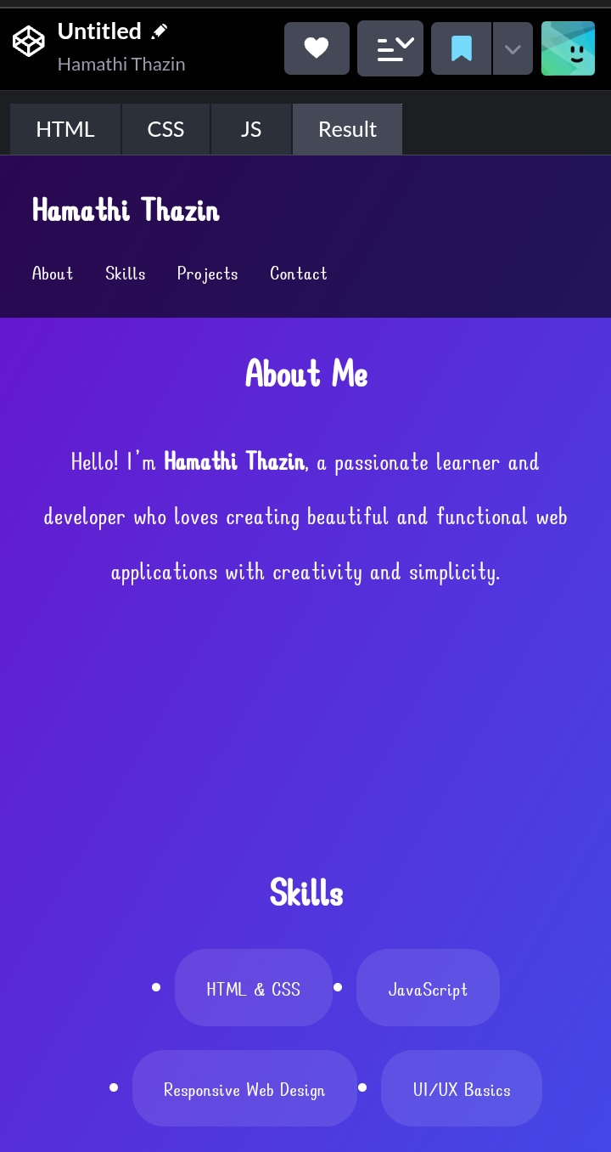
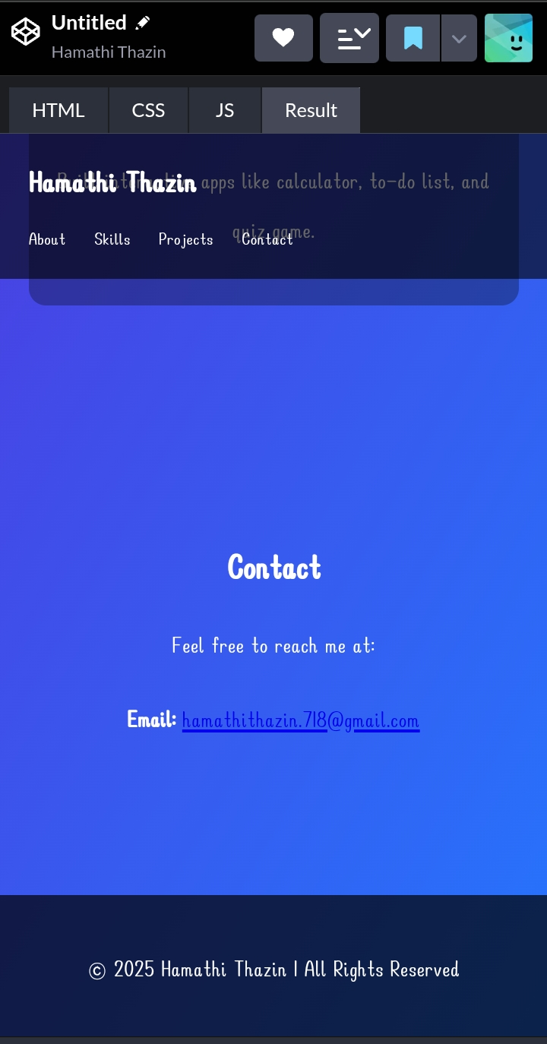
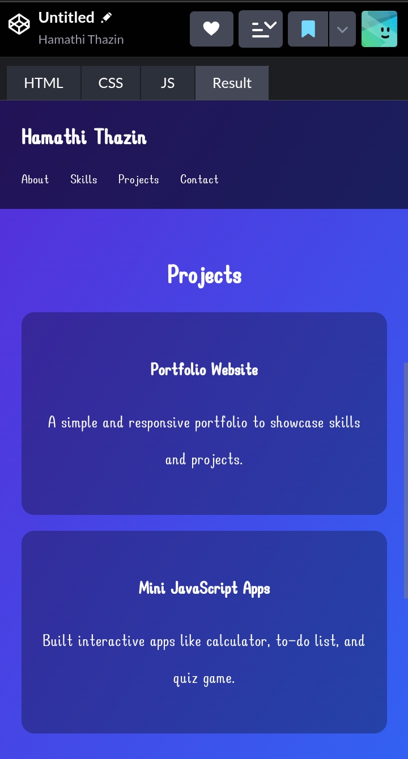

RESULTS AND SCREENSHOTS
3/21/2024 Annual Review
15

Slide 16
CONCLUSION
The portfolio website for Hamathi Thazin successfully demonstrates a modern and professional digital presence. It integrates HTML, CSS, and JavaScript to build a clean structure, stylish design, and interactive functionality. With sections like About Me, Skills, Projects, and Contact, it provides recruiters, clients, and collaborators with an easy way to understand your abilities and reach you.
Key strengths include its responsive layout, smooth animations, and user-friendly navigation, ensuring a positive experience across devices. This portfolio not only highlights technical skills but also serves as a personal brand identity, making it a valuable tool for career opportunities, freelance work, and networking.
16

Slide 17
GITHUB LINK
https://github.com/hamathithazin718-blip/Hamathi-Thazin-

